Slide 1

Mentor Name: Neha Gupta Date:27/10/2022
Hourly Energy Consumption Forecast
Team No: Team 5
1.Aniket Nandkumar Kumbhar
2.Ramazan Abdul Raheem
3.Ankita S. Patil
4.Pranjali Uday Shinde
5.Pranjal Sharma
6.Priyanka . J

Slide 2
Business Objective
PJM Interconnection LLC (PJM) is a regional transmission organization (RTO) in the United States. It is part of the Eastern Interconnection grid operating an electric transmission system serving all or parts of Delaware, Illinois, Indiana, Kentucky, Maryland, Michigan, New Jersey, North Carolina, Ohio, Pennsylvania, Tennessee, Virginia, West Virginia, and the District of Columbia.
The hourly power consumption data comes from PJM's website and are in megawatts (MW).
Split the last year into a test set- can you build a model to predict energy consumption?
Find trends in energy consumption around hours of the day, holidays, or long term trends?
Understand how daily trends change depending of the time of year. Summer trends are very different than winter trends.
To predict for next 30 days energy Consumption.

Slide 3
Project Lifecycle
Data Analysis
Feature Engineering
Feature Extraction
Model Building
Model Deployment

Slide 4
Exploratory Data Analysis (EDA) and
Feature Engineering
Missing values
Duplicated values
Outlier Detection
Feature Scaling
Feature Extraction
Correlation
Skewness Removal
Data Insights
Stationarity Test
Autocorrelation Function
Partial Autocorrelation Function
Lag plots
Normal Distribution Analysis
Relationshop between independent and dependent feature (PJMW_MW)

Slide 5
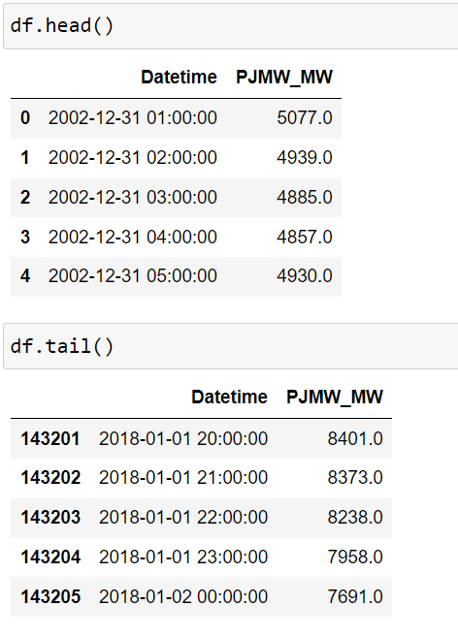
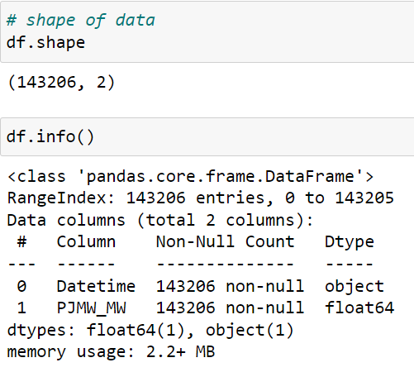
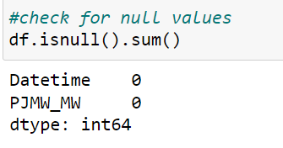
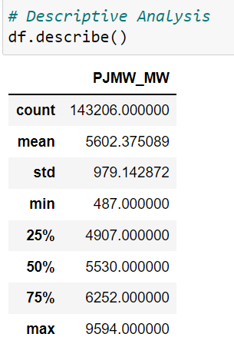
Data set details

Slide 6
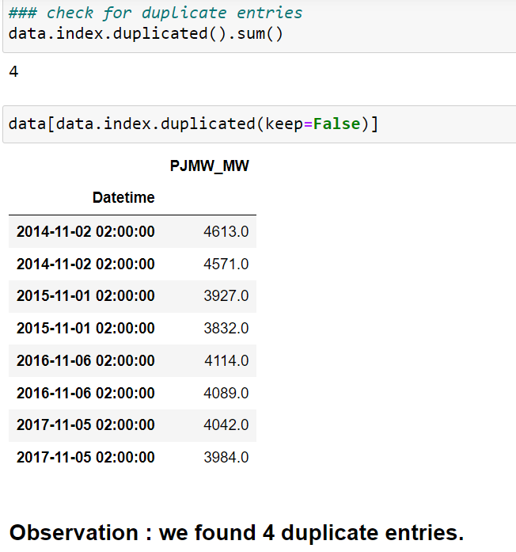
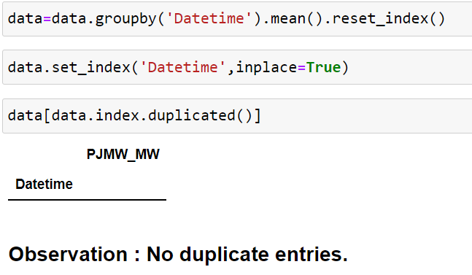
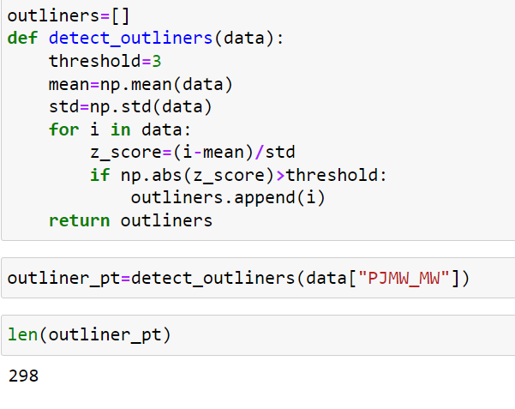
Duplicate Values

Slide 7
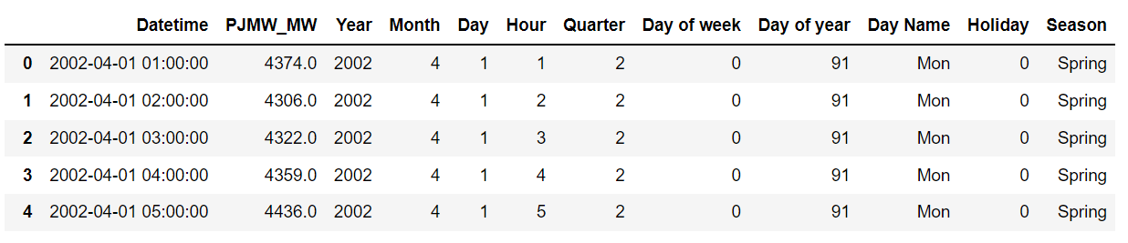
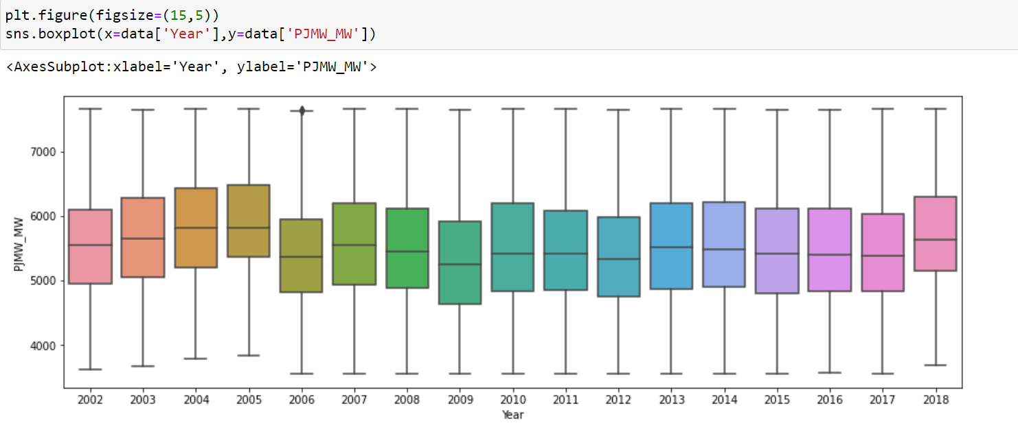
EDA-Feature Extraction

Slide 8
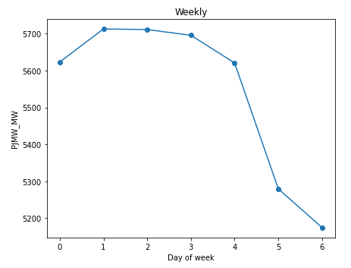
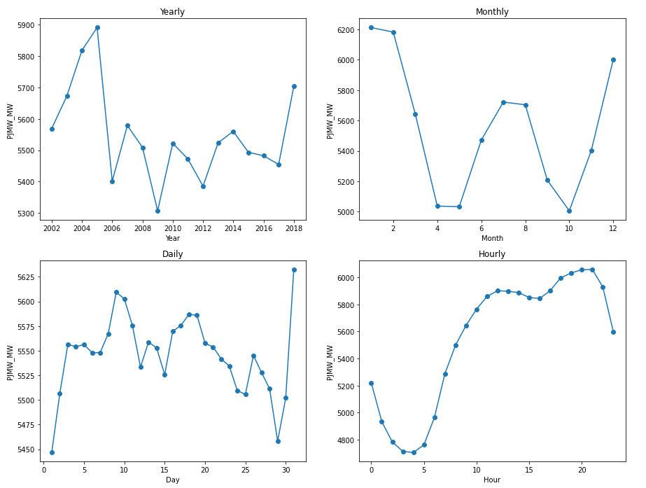
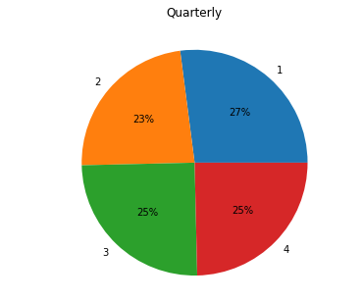
Energy Consumption on Hourly, Daily, Weekly, Monthly and Yearly Basis

Slide 9
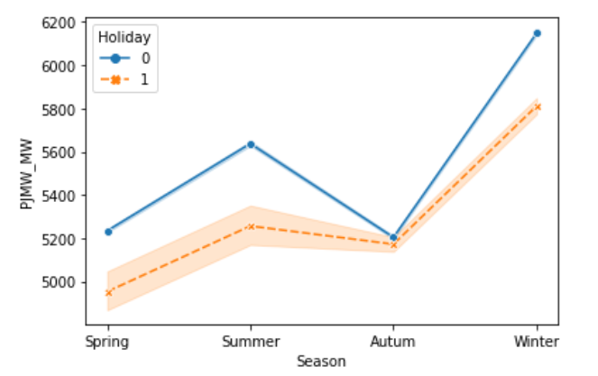
Energy Consumption on Seasons and Holidays

Slide 10
Model Building
Arima Model
Sarima Model
Linear Regression
Random Forest
XGBoost

Slide 11
ARIMA Model (Autoregressive integrated moving average)
Stationarity Check:
1. Dickey-Fuller Test
2. ACF and PACF Plots
Non- Stationarity Data to make it Stationary:
1. Differencing
2. Lag transformation
3. Rolling mean
4. Exponential function

Slide 12
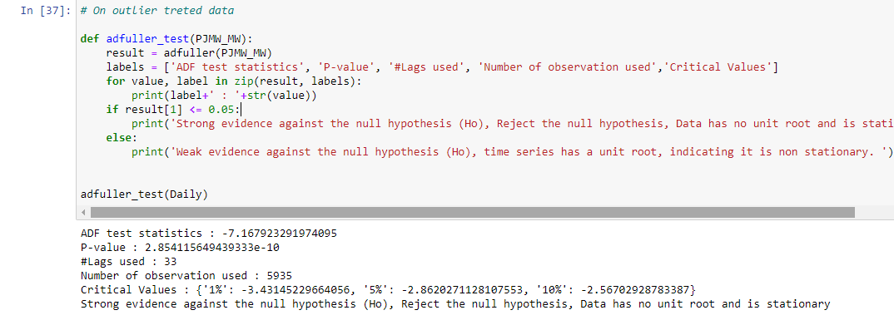
Dickey-Fuller Test : For stationarity check

Slide 13
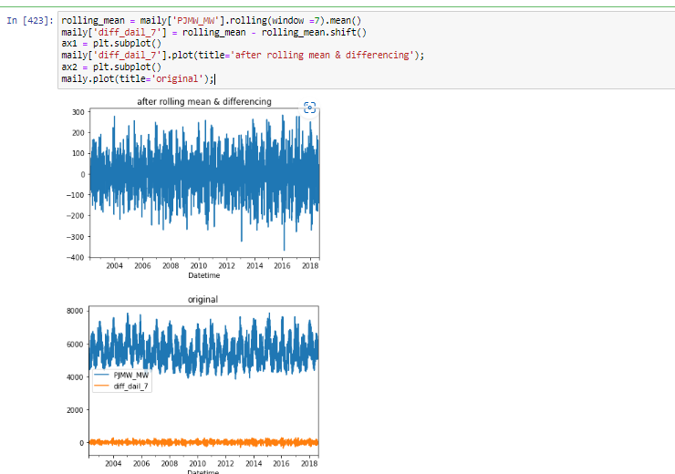
Differencing by Rolling mean

Slide 14
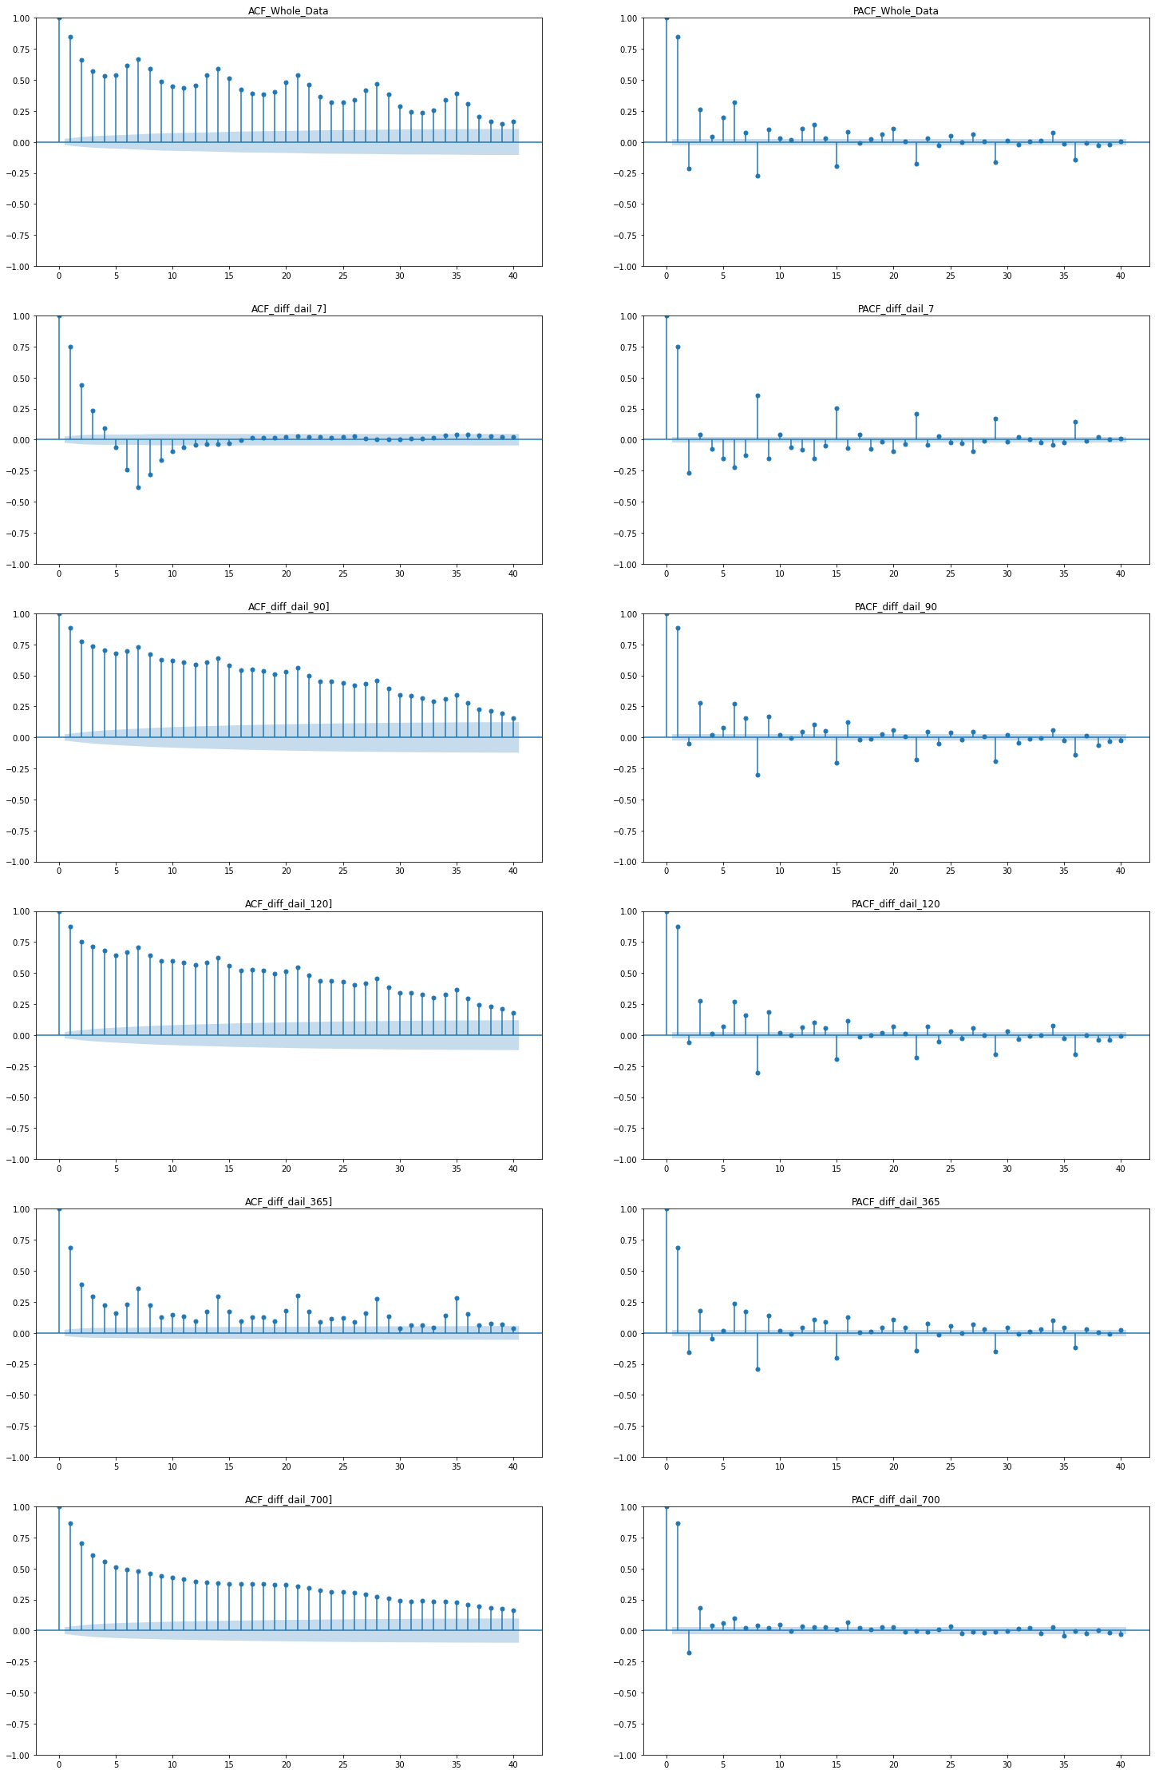

ACF & PACF Plots
Daily Differencing
Hyperparameters
P=0,1 ,D=1, Q=0,1
d=1, p= 1,2, q=1,3

Slide 15
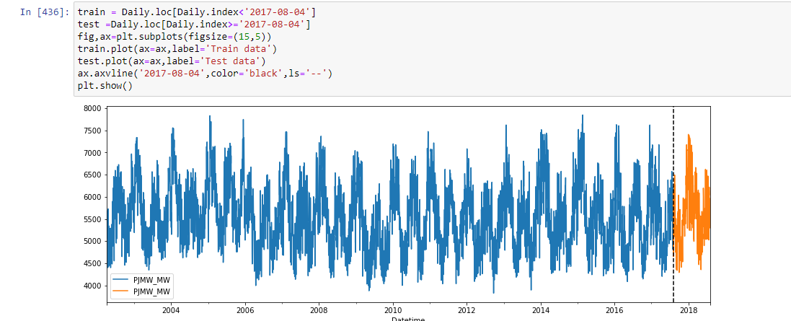
Train and Test split

Slide 16
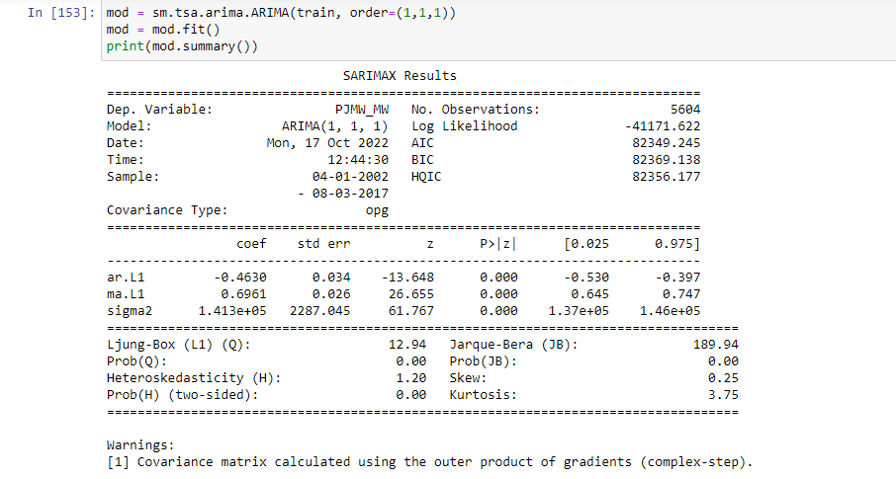
Arima Model Results

Slide 17
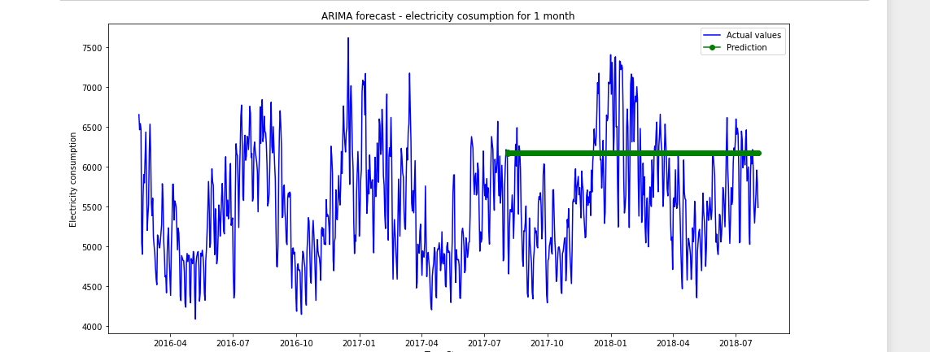
Arima Model

Slide 18
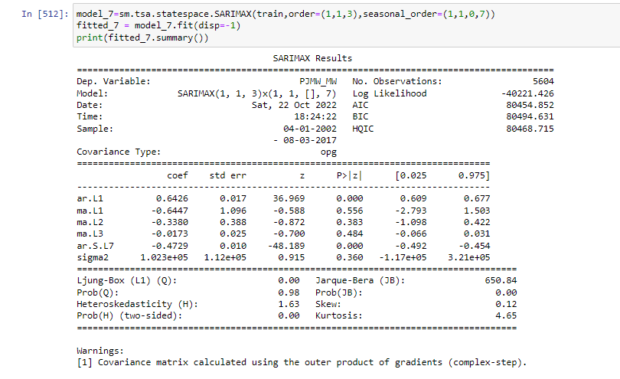
Sarima Model Results
Sarima 7 days

Slide 19
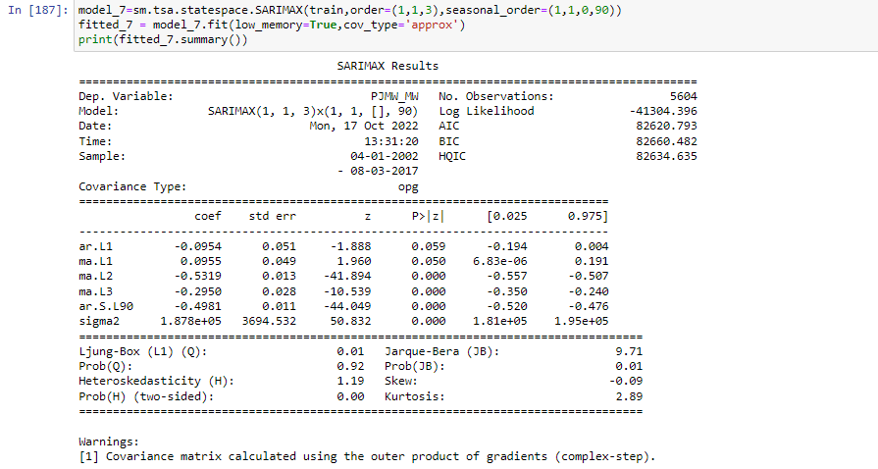
Sarima Model Results
Sarima 90 days

Slide 20
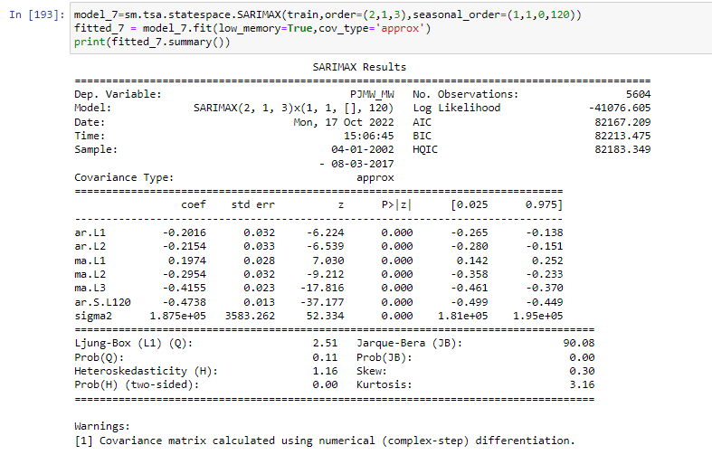
Sarima Model Results
Sarima 120 days

Slide 21
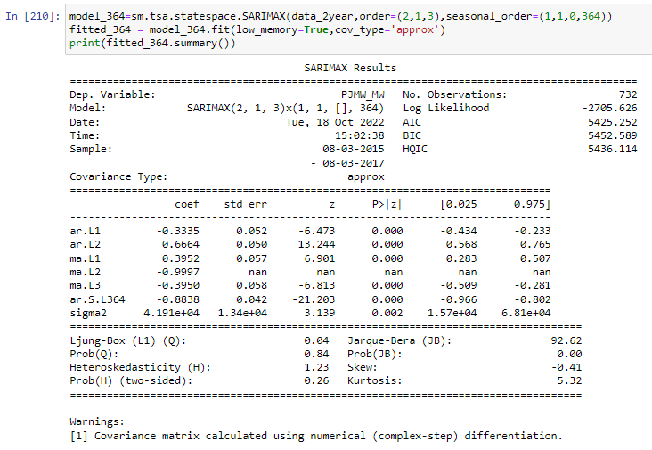
Sarima Model Results
Sarima 365 days

Slide 22
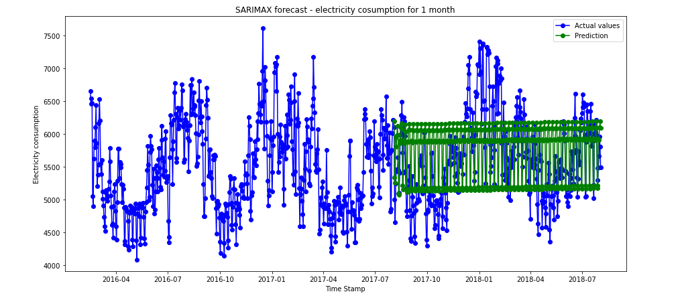
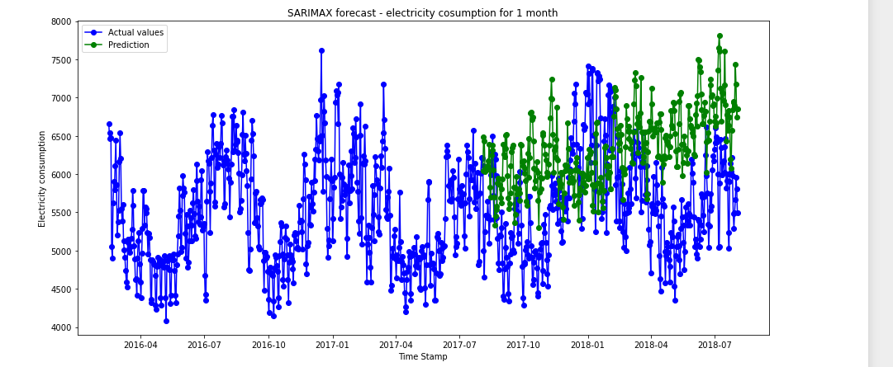
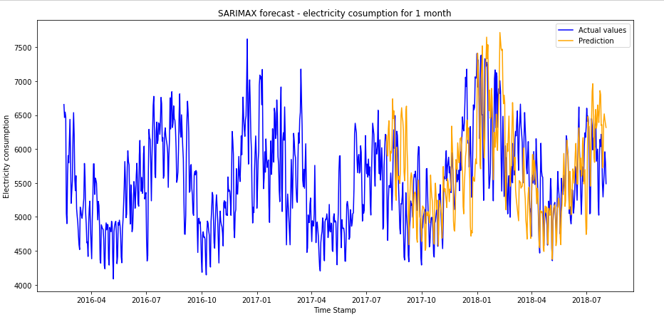
SARIMA 7 DAYS
Sarima Model
SARIMA 120 DAYS
SARIMA 365 DAYS

Slide 23
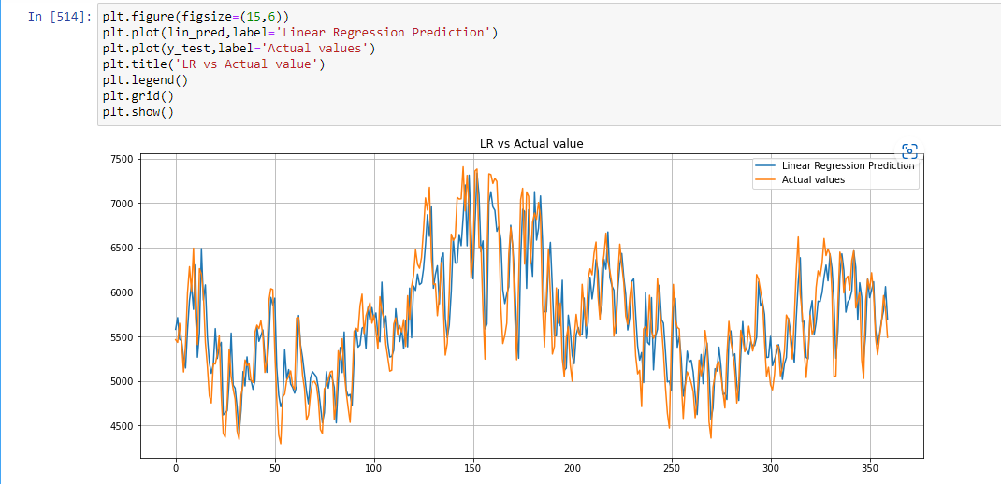
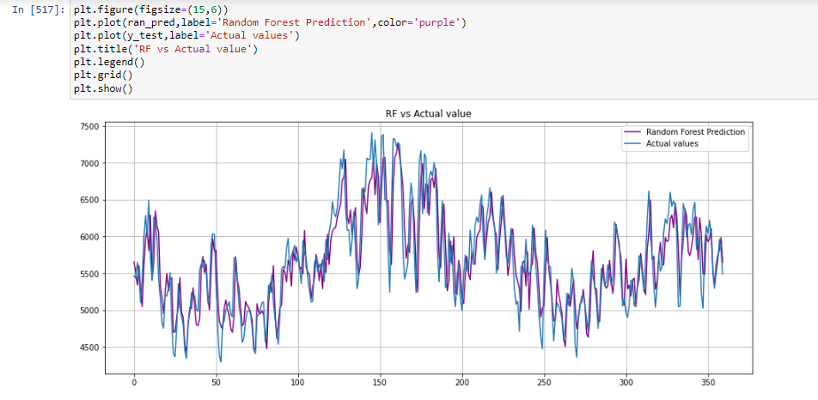
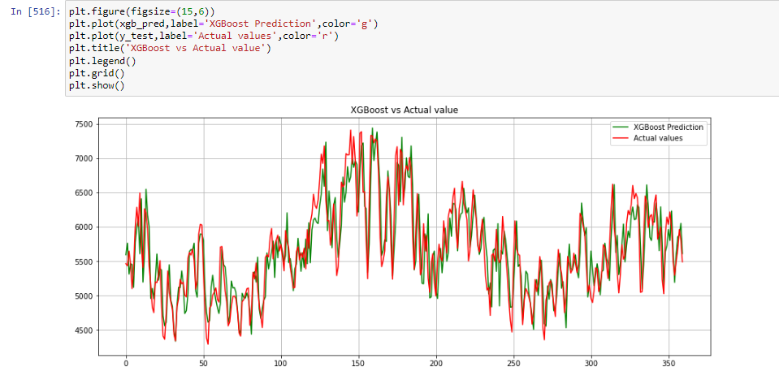
LINEAR REGRESSION
RANDOM FOREST
XGBOOST

Slide 24
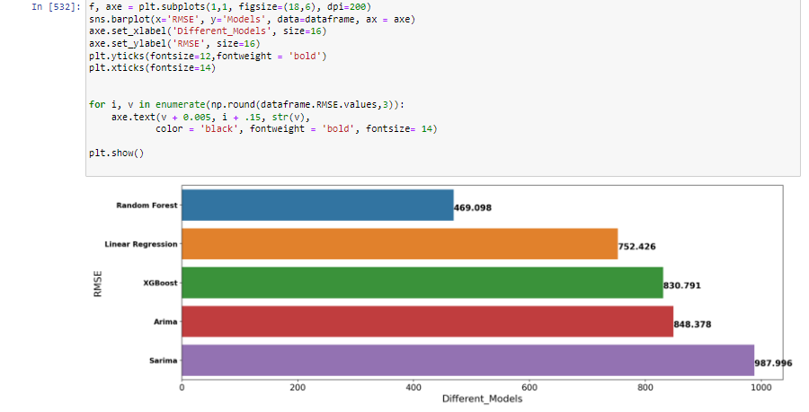
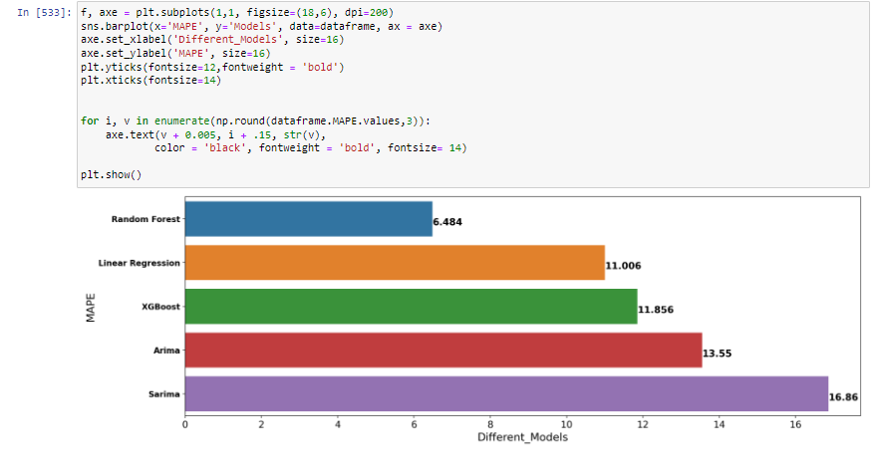
RMSE & MAPE Values
As lowest RMSE & MAPE values consider the best fitted model.
So we will use ‘Random forest’ as Final model for prediction purpose.

Slide 25
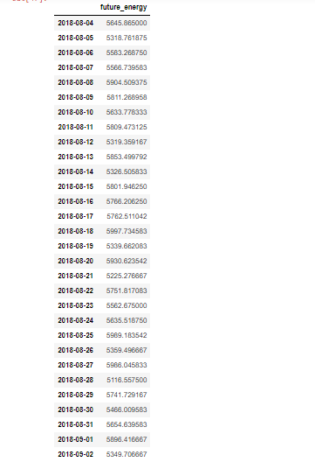
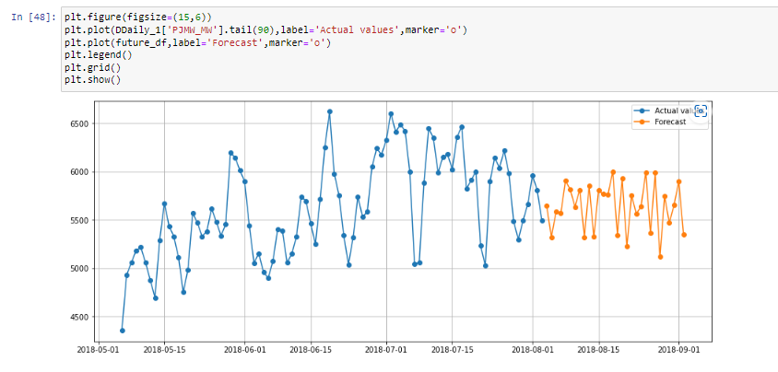
Model Results
Final Predictions with Random Forest

Slide 26
Model Deployment using Stream lit

Slide 27
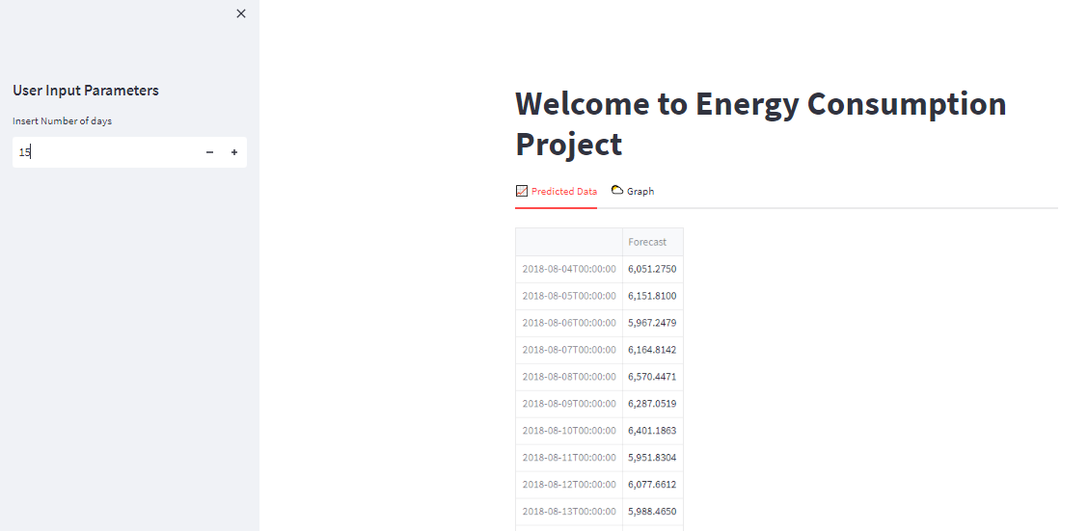
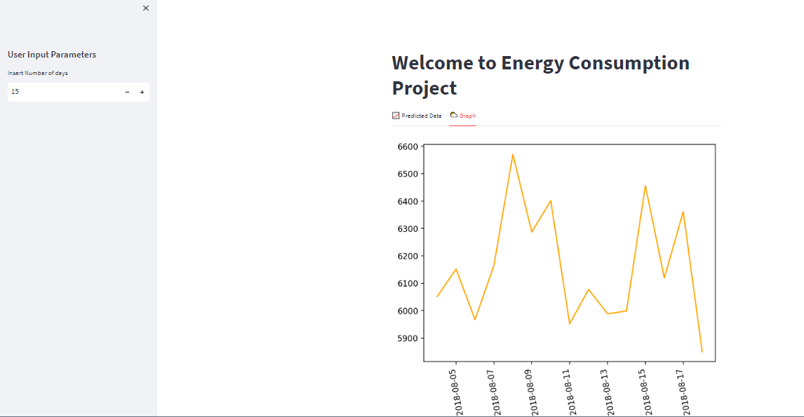
Model Deployment using Stream lit

Slide 28
Thank you

